Slide 1

Introduction to Java Programming
Brian Craig

Slide 2
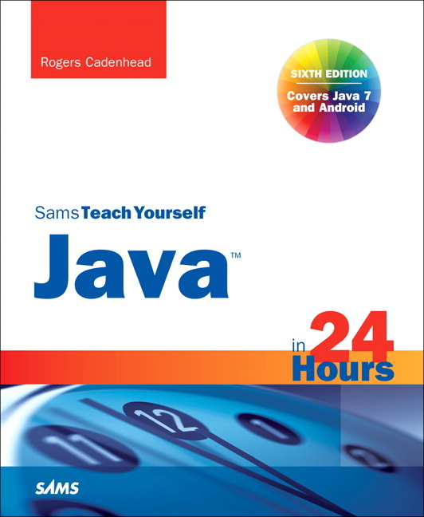
Text
Sams Teach Yourself Java in 24 Hours
6th Edition
Rogers Cadenhead

Slide 3
Hour 1
Becoming a Programmer

Slide 4
What is a Programming Language
Programming languages work like spoken language
Gives humans a way to tell a computer what to do

Slide 5
Choosing a Language
Languages
BASIC
Visual Basic
C#
C++
Java
100’s of others
Why Java?
Used on internet & mobile phones
Organized language
Invented by James Gosling
Didn’t like C++
3 billion devices run Java
Learning one language makes it easy to learn others

Slide 6
Telling the Computer What to Do
Computer Program = Software
Everything a computer does is done by software
Examples:
Windows 8, Minecraft, Internet Explorer, iTunes, viruses
Programs made up of list of commands to be performed in a specific order
Command = Statement
Example:
Clean your room
Mow the lawn
Play videogames
Go to bed

Slide 7
Telling the Computer What to Do
Go to: www.calormen.com/applesoft
Enter the following commands:
10 PRINT “Shall we play a game?”
20 INPUT A$

Slide 8
How Programs Work
Interpreted Languages
Compiled Languages

Slide 9
When Programs Don’t Work
Syntax Errors
Broke the rules of the language
Computer doesn’t understand
Compile-time error
Logic Errors
Obeys the rules of the language
Computer doesn’t do what you want or expect
Run-time error

Slide 10
Choosing a Java Programming Tool
Java Development Kit (JDK)
NetBeans Integrated Development Environment (IDE)

Slide 11
Installing a Java Development Tool
Use the provided CD
Install JDK on your PC
Try 64-bit version first
If it does not work, use x86 version
Install Netbeans on you PC

Slide 12
Summary
Concept of Programming – Giving instructions
Installed JDK and Netbeans

